Slide 1

ratings prediction
By Ashok Kumar Sharma

Slide 2
ACKNOWLEDGMENT
I would like to express my deep sense of gratitude to my SME (Subject Matter Expert) Mr. Shubham Yadav as well as Flip Robo Technologies who gave me the golden opportunity to do this data scraping and analysis project on Ratings Prediction, which also helped me in doing lots of research and I came to know about so many new things.
I am very much thankful to Mr. Shankargouda Tegginmani, Trainer (DataTrained), for their valuable guidance, keen interest and encouragement at various stages of my training period which eventually helped me a lot in doing this project.
I also acknowledge with thanks for suggestion and timely guidance, which I have received from my SME Mr. Shubham Yadav during this project, which immensely helped me in the evaluation of my ideas on the project.
Ashok Kumar Sharma

Slide 3
introduction
Business Problem Framing
Websites and online stores increasingly rely on rating systems and interactive elements for visitors and customers: users leave ratings on websites or give their opinions on products and companies using the comment boxes embedded on the page. The added value for users is clear: Customers and website visitors often gain important information through ratings and can read other user’s experiences before investing in a product, service, or company. Since it’s not possible to take a closer look at products online, these ratings and reviews fill information gaps. Online shopping is convenient, practical, and fast, but nonetheless there’s a distance between the provider and the customer. However, if a website contains ratings or a comment box, this can help to close the distance between the provider and the customer: Customers can then use the feedback to help each other decide whether to go ahead with the purchase by providing information on the function, range, and value of a product.

Slide 4
introduction
Conceptual Background of the Domain Problem
This project is related a website where people write different reviews for technical products. Now a new feature has been added to website i.e., the reviewer will have to add stars (rating) as well with the review. The rating is out 5 stars and it only has 5 options available 1 star, 2 stars, 3 stars, 4 stars, 5 stars. Now the requirement is to predict ratings for the reviews which were written in the past for which website don’t have a rating. So, we have to build an application which can predict the rating by seeing the review.

Slide 5
introduction
Review of Literature
What is rating?
Rating is a classification or ranking of someone or something based on a comparative assessment of their quality, standard, or performance.

Slide 6
introduction
Motivation for the Problem Undertaken
This model will be used by the websites where reviews are available but not the corresponding rating(s). This will help in assigning particular rating(s) for the given reviews.

Slide 7
Analytical Problem Framing
Mathematical/ Analytical Modeling of the Problem
For checking datatypes and null values, pandas.DataFrame.info() method has been used. To change the column name pandas.DataFrame.rename() method has been used and to drop the null values pandas.DataFrame.dropna() method has been used. To replace and remove the certain terms and punctuations, pandas.Series.str.replace() method with regular expression has been used. To get rid of stop words, nltk.corpus.stopwords() method has been used.

Slide 8
Analytical Problem Framing
Data Inputs- Logic- Output Relationships
Input | Logic (algorithm) | Output
Review_text (object) | MultinomialNB SGDClassifier KNeighborsClassifier DecisionTreeClassifier | rating
There is 1 input variable needs to be provided to the logic to get the output i.e. rating. Logic highlighted in bold i.e. SGDClassifier is the best performing algorithm among all other logics on this dataset.

Slide 9
Analytical Problem Framing
Data Sources and their formats
The dataset is being created by scrapping different e-commerce websites and saved in .CSV (Comma Separated Values) format. Dataset consists of 31585 rows with 3 features.

Slide 10
Analytical Problem Framing
Data Preprocessing Done
The following pre-processing pipeline is required to perform model prediction:
Load Dataset
Merge feature Review Titles and Review Descriptions to review_text
Drop columns Review Titles and Review Descriptions
Treat Null Values by dropping null value rows using pandas dropna() method.
Convert review_text to lower-case.
Remove punctuations, leading whitespaces, trailing whitespaces and replace money symbols with 'dollars', numbers with 'numbr', white space between terms with single space.
Remove Stop Words
Convert Text into Vectors using TfidfVectorizer
Load Serialized Model
Predict Output by Supplying Input.

Slide 11
Analytical Problem Framing
Hardware and Software Requirements and Tools Used
During this project following set of hardware is being used: RAM: 8 GB CPU: AMD A8 Quad Core 2.2 Ghz GPU: AMD Redon R5 Graphics and the following software and tools is being used: Python Jupyter Notebook Anaconda | With following libraries and packages: Pandas Numpy Matplotlib Seaborn nltk wordcloud sys Timeit IPython sklearn

Slide 12
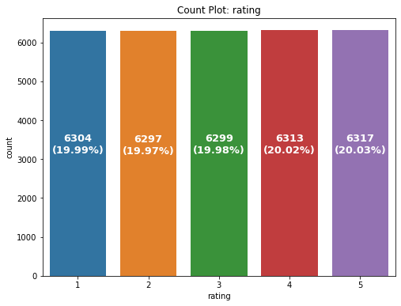
Exploratory Data analysis (eda) & visualization
Univariate Analysis
Univariate analysis is the simplest form of data analysis where the data being analyzed contains only one variable. In this project, distribution plot, count plot, box plot and bar plot has been used.
Count Plot:
Remarks:
There are almost equal number of records are availble for all ratings i.e. from 1 to 5.

Slide 13
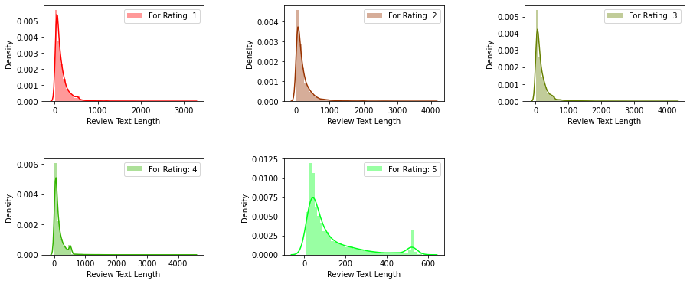
Exploratory Data analysis (eda) & visualization
Univariate Analysis: Distribution Plot
Remarks:
Rating 2, 3, 4 has almost similar review text length and higher than Rating 1 and 5.
Rating 5 has lowest review text lengths.

Slide 14
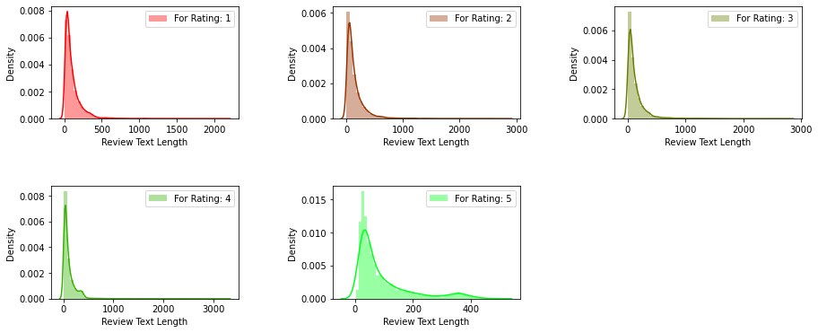
Exploratory Data analysis (eda) & visualization
Univariate Analysis: Distribution Plot
Remarks:
Review text length reduced by almost 1000 characters for Rating 1 to 4 while for Rating 5 it is almost 200 characters

Slide 15
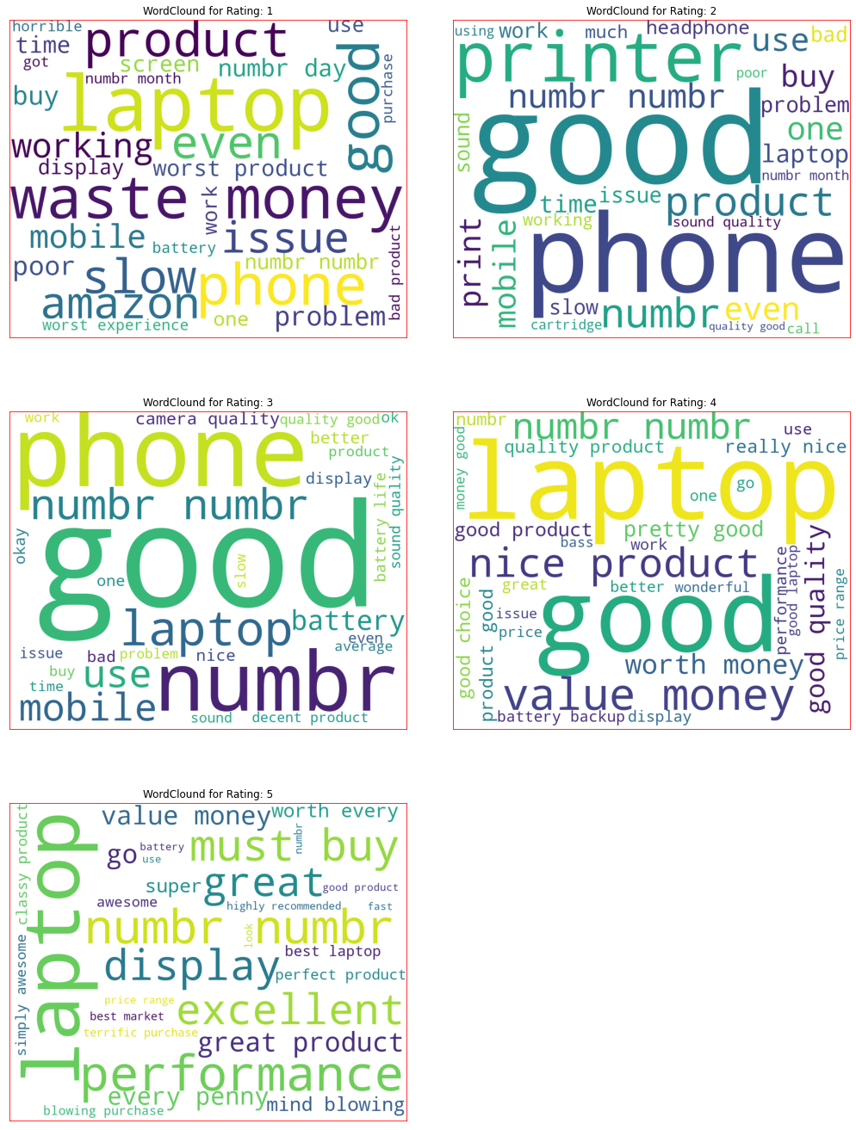
Exploratory Data analysis (eda) & visualization
Word Cloud : Display

Slide 16
Exploratory Data analysis (eda) & visualization
Word Cloud : Display

Slide 17
Exploratory Data analysis (eda) & visualization
Word Cloud : Display

Slide 18
Exploratory Data analysis (eda) & visualization
Word Cloud : Remarks
for Rating: 1
It mostly consists of words like laptop, waste, money, slow, worst, issue, horrible etc.
for Rating: 2
It mostly consists of words like phone, good, printer, product, problem, issue, bad, poor, slow etc.
for Rating: 3
It mostly consists of words like phone, good, laptop, problem, bad, issue, slow, life, average, nice etc.
for Rating: 4
It mostly consists of words like laptop, good, value, money, nice, performance, great, better, wonderful etc.
for Rating: 5
It mostly consists of words like laptop, excellent, must buy, great, perfect, super, awesome, mind blowing etc.

Slide 19
Exploratory Data analysis (eda) & visualization
Concluding Remarks
Starting with univariate analysis, with the help of countplot, it was found that the data consists of almost in equal amount for each rating (i.e., from 1 to 5). Moving further with the removal and replacement of certain terms (like, punctuations, extra spaces, numbers, money symbols) as well as removal of stop words, it was evident that the length of review text decreases by a large amount. This was also depicted by using distribution plot. With the help of wordcloud, it was found that the rating 1 consists of words like waste, money, slow, worst, issue, horrible etc., rating 2 consists of words like problem, issue, bad, poor, slow etc., rating 3 consists of word like problem, bad, issue, slow, life, average, nice etc., rating 4 consists of word like good, value, money, nice, performance, great, better, wonderful etc. and rating 5 consists of words like excellent, must buy, great, perfect, super, awesome, mind blowing etc.

Slide 20
Model/s Development and Evaluation
Identification of possible problem-solving approaches (methods)
To solve this problem following steps are used:
Load Dataset using pandas
Merge feature Review Titles and Review Descriptions to review_text.
Drop columns Review Titles and Review Descriptions.
Treat Null Values by dropping null value rows using pandas dropna() method.
Convert review_text to lower-case.
Remove punctuations, leading whitespaces, trailing whitespaces and replace money symbols with 'dollars', numbers with 'numbr', white space between terms with single space.
Remove Stop Words.
Convert Text into Vectors using TfidfVectorizer.
Separate Input and Output Variables.
Train & Test the Model by supplying Input and Output Variables.

Slide 21
Model/s Development and Evaluation
Testing of Identified Approaches (Algorithms)
Following are the list of algorithms used for training and testing:
MultinomialNB
SGDClassifier
KNeighborsClassifier
DecisionTreeClassifier

Slide 22
Model/s Development and Evaluation
Run and Evaluate selected models
 | Name | Initial Score | Cross Val Score | Final Score | Build Time | Difference (Final Score - Cross Val Score)
0 | MultinomialNB | 0.734999 | 0.724785 | 0.734999 | 4.174949800000007 (in sec.) | 0.010214
1 | SGDClassifier | 0.751617 | 0.750877 | 0.759229 | 94.5427563 (in sec.) | 0.008352
2 | KNeighborsClassifier | 0.436128 | 0.587389 | 0.550679 | 1241.6716397 (in sec.) | -0.036710
3 | DecisionTreeClassifier | 0.672460 | 0.662916 | 0.677280 | 2772.7051459000004 (in sec.) | 0.014364
A total of 4 algorithm has been used on this dataset for training testing purpose, these are MultinomialNB, SGDDClassifier, KNeighborsClassifier and DecisionTreeClassifier. From the above model performance comparison it is clear that SGDClassifier out-performs the other models with accuracy_score of 75.92% and lowest difference between accuracy_score and cross_val_score. Therefore, continuing with SGDClassifier as final model.

Slide 23
Conclusion
Key Findings and Conclusions of the Study
From the model performance comparison it is clear that SGDClassifier out-performs the other models with accuracy_score of 75.92% and lowest difference between accuracy_score and cross_val_score. Therefore, continuing with SGDClassifier as final model.

Slide 24
Conclusion
Learning Outcomes of the Study in respect of Data Science
During the data analysis, review_text feature contains null values which I have dropped. But these values can also be replaced with some other values which might impact the model performance either in positive or negative way. As of now, I am finishing this project with my current approach which gives the final accuracy score of 75.92% and cross_val_score: 75.08% and this can be further improved by training with more specific data.

Slide 25
Conclusion
Limitations of this work and Scope for Future Work
Current model is limited to technical product rating(s) and reviews data but this can further be improved for other sectors of ecommerce rating(s) prediction by training the model accordingly. The overall score can also be improved further by training the model with more specific data.

